Slide 1
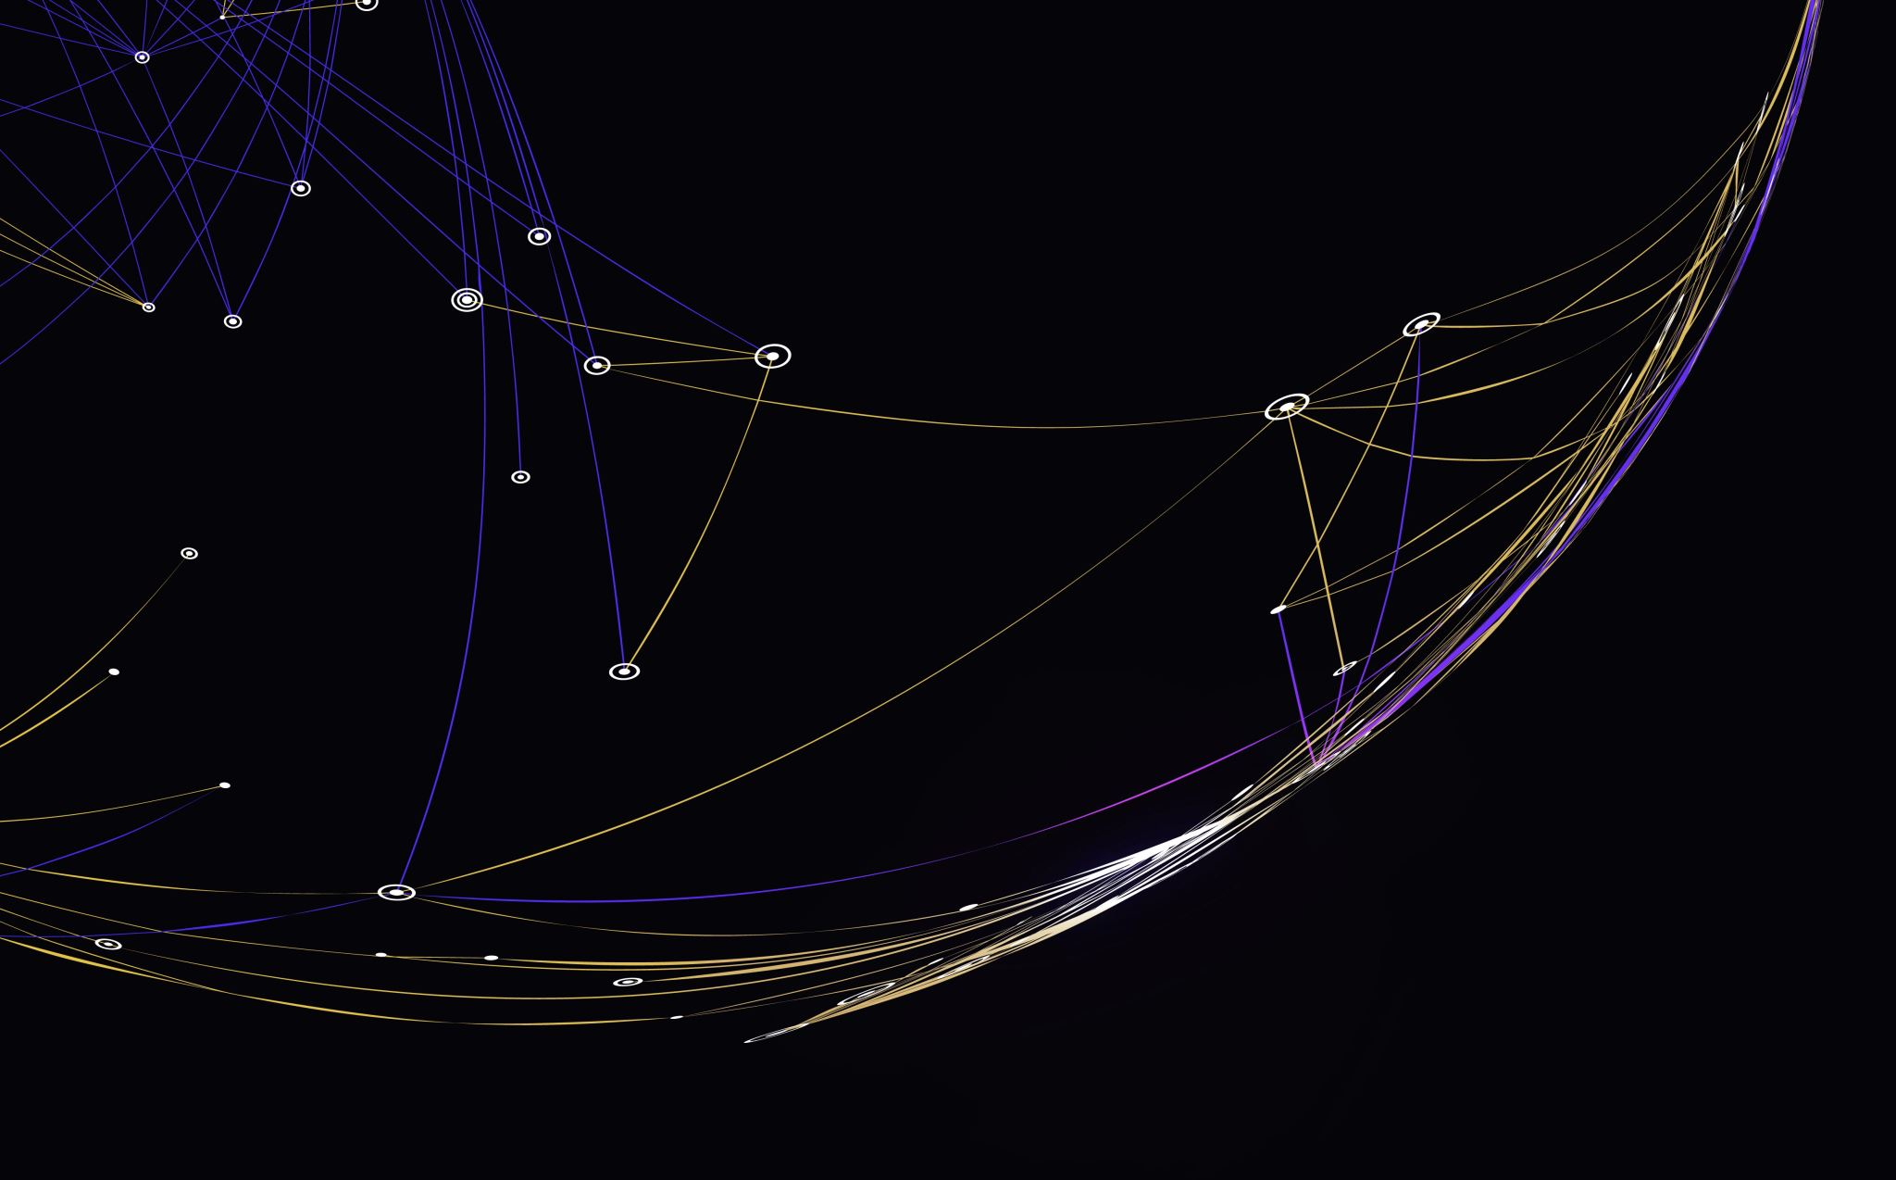
Formatting
Clean Code – Chapter 5

Slide 2
Introduction
Clean, well-formatted code reflects professionalism and attention to detail. While messy code suggests carelessness throughout the entire project.
So,
you should take care that your code is nicely formatted.
choose a set of simple rules that govern the format of your code, and then you should consistently apply them.
If you are working on a team, then the team should agree to a single set of formatting rules.

Slide 3
The Purpose of Formatting
Code formatting is about communication, and communication is the professional developer’s first order of business.
The functionality you create today has a good chance of changing in the next release, but the readability of your code will have a profound effect on all the changes that will ever be made.
Your style and discipline survives, even though your code doesn’t.

Slide 4
Vertical Formatting – Introduction
How big are most Java source files?
It turns out that there’s a huge range of sizes and some remarkable differences in style.
There’s no absolute rule, keeping source files small (under 200-500 lines) makes code more manageable and easier to understand.

Slide 5
Vertical Formatting – The Newspaper Metaphor
We would like a source file to be like a newspaper article.
The name should be simple but explanatory.
The topmost parts of the source file should provide the high-level concepts and algorithms.
Detail should increase as we move downward, until at the end we find the lowest level functions and details.
If the newspaper were just one long story containing a disorganized agglomeration of facts, dates, and names, then we simply would not read it.

Slide 6
Vertical Formatting – Vertical Openness Between Concepts
Each group of lines represents a complete thought.
These thoughts should be separated from each other with blank lines
Each blank line is a visual cue that identifies a new and separate concept.

Slide 7
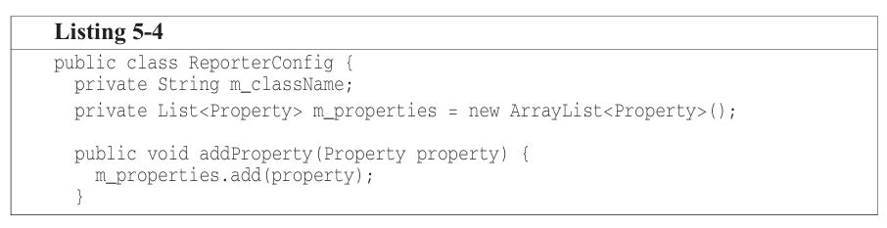
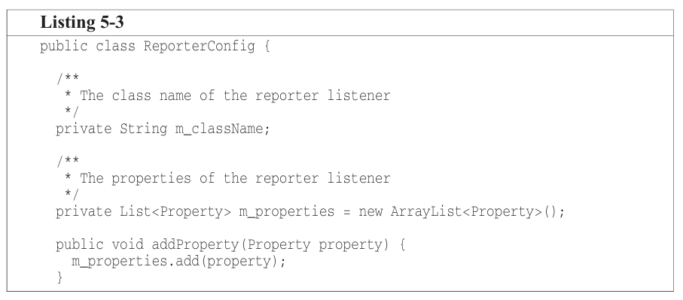
Vertical Formatting – Vertical Density
If openness separates concepts, then vertical density implies close association.
So, lines of code that are tightly related should appear vertically dense.

